Slide 1
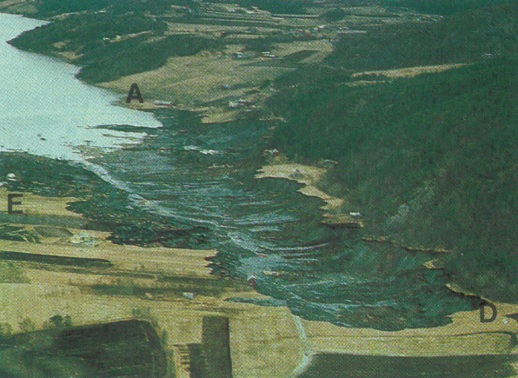
The QUICK CLAY LANDSLIDE IN RISSA, NORWAY
Group 10:
Brian Peterson
Ben Lesa
Travis Meservy
Jacob Nelson

Slide 2
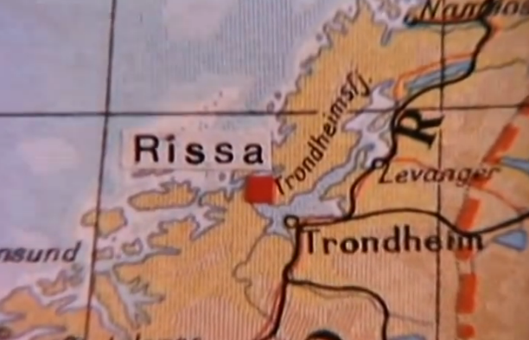
introduction
Rissa, Norway
April 29, 1978
330,000 m²
7 Farms
5 single Family Homes
1 killed

Slide 3
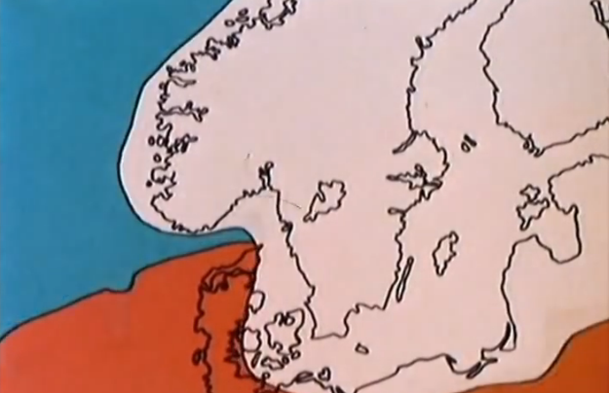
Formation of quick clay
Legend:
Original
Water
Retreating Ice

Slide 4
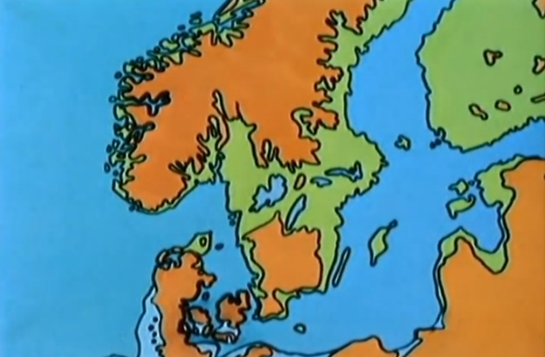
Formation of quick clay
Legend:
Original
Water
Silt and Clay Deposit

Slide 5
Formation of quick clay
Seepage causes the removal of salt from the soil
Seepage
Bedrock

Slide 6
Quick clay Properties

Slide 7
Landslide phases

Slide 8
Phase a

Slide 9
STARTS HERE
EXCAVATION
DEPOSIT

Slide 10
Video footage

Slide 11
Phase b

Slide 12
Phase c

Slide 13
PHASE C
LIQUEFIED QUICK CLAY

Slide 14
Phase c

Slide 15
Phase d

Slide 16
Phase e

Slide 17
Final

Slide 18
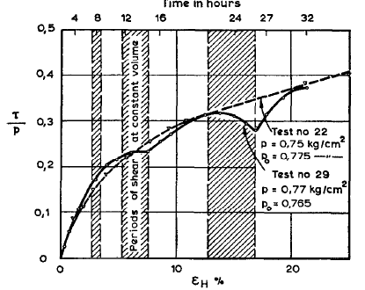
Research
Direct Shear Tests
Critical Stress < Ultimate Strength

Slide 19
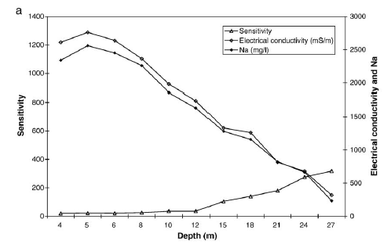
research
Chemical Behavior
Salt and Sensitivity

Slide 20
Questions

Slide 21
REFERENCES
1. Landva, L. B. Direct Simple-Shear Tests on a Norwegian Quick Clay.
2. L'Heureux, J. (n.d.). The 1978 Quick Clay Landslide at Risa, Mid NOrway: Subaqueous Morphology and Tsunami Simulation. Retrieved from http://www.researchgate.net/profile/Jean-Sebastien_LHeureux/publication/236164959_The_1978_quick_clay_landslide_at_Rissa_mid_Norway_subaqueous_morphology_and_tsunami_simulations/links/0deec51f92d9b96b57000000.pdf
3. Y. Andersson-Sko¨ld et al. / Engineering Geology 82 (2005) 107–118
4. https://www.youtube.com/watch?v=3q-qfNlEP4A

